Slide 1
Enterprise Architecture Management
Introduction to EAM
BOC Academy Programme
Supported by: www.adoit-community.com

Slide 2
Agenda
Your Key Takeaway from this Lecture:
What are models?
Why modelling at all?
ArchiMates Motivation Layer
Notes:
shutterstock_523858522

Slide 3
EA Deliverables in the Form of Models
Notes:
shutterstock_594255065

Slide 4
Why Models?
Each person/department has a different view of the organization
Models allow us to see a full picture
(„connected view”) and facilitate
better communication!
!

Slide 5
We use Models Every Day!
„The most that can be expected from any model is that it can supply a useful approximation to reality: All models are wrong; some models are useful”
George Box
Famous British statistician
Models can have different purposes
Notes:
shutterstock_134068748, shutterstock_1271685691, shutterstock_555003484

Slide 6
There are various Types of Models
Models can describe existing reality
They can also be used to plan new reality

Slide 7
Models should be adjusted to the Audience Needs
Even one concept can be described with various models: depending on the purpose, audience, level of formality etc.

Slide 8
How to make sure our Model is useful?
Each modelling language, programming language or spoken language has some properties
Syntax Grammar rules
Semantics Meaning
And sometimes also Pragmatics (best practices) Interpretation depending on the Situation
Notes:
shutterstock_90031093

Slide 9
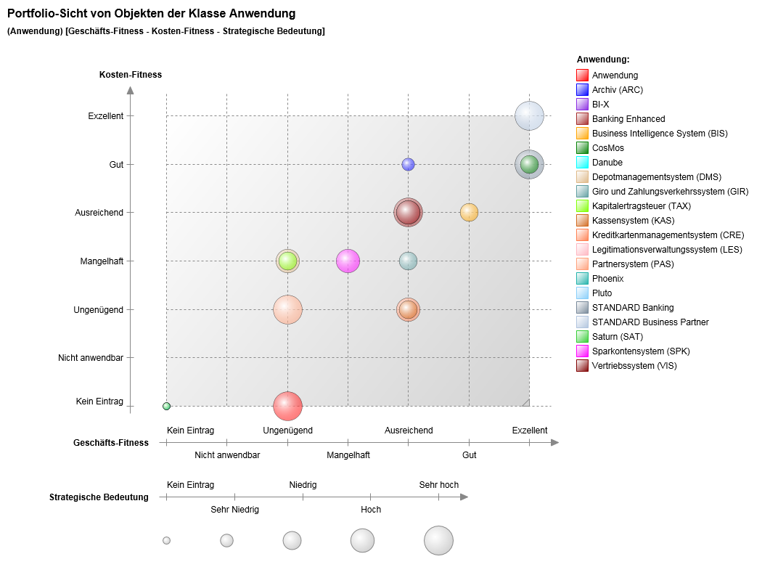
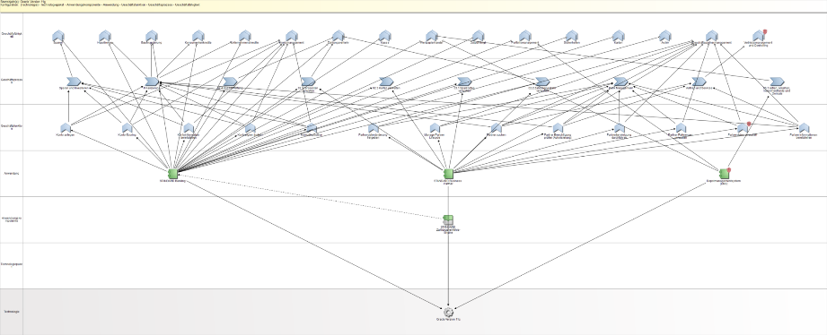
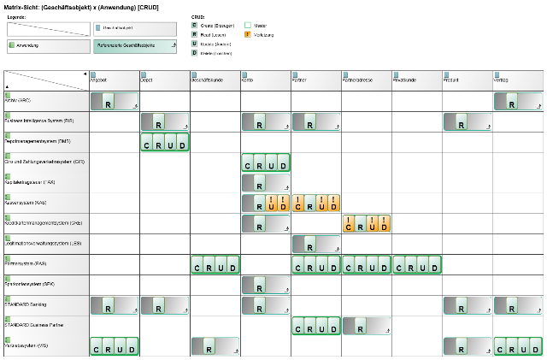
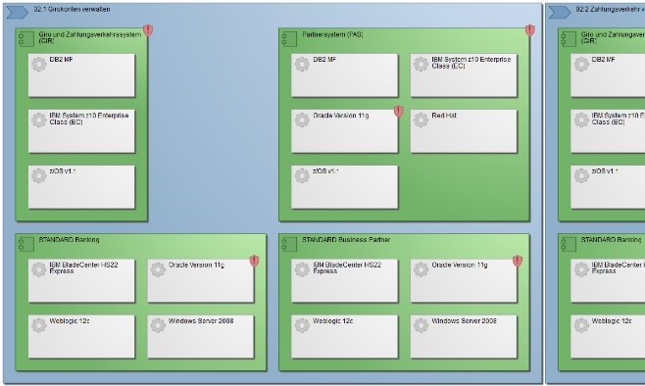
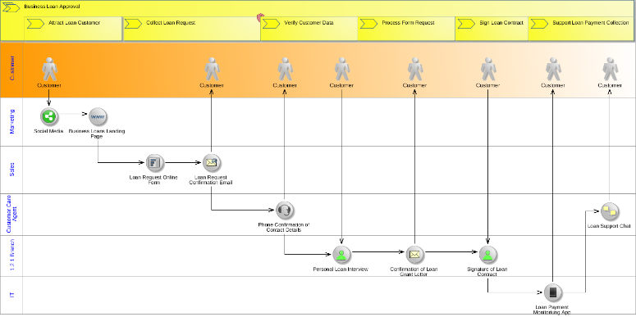
Typical models in EA
Source: www.adoit-community.com

Slide 10
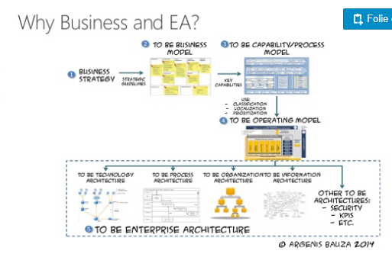

Slide 11
Agenda
Your Key Takeaway from this Lecture:
What are models?
Why modelling at all?
ArchiMates Motivation Layer

Slide 12
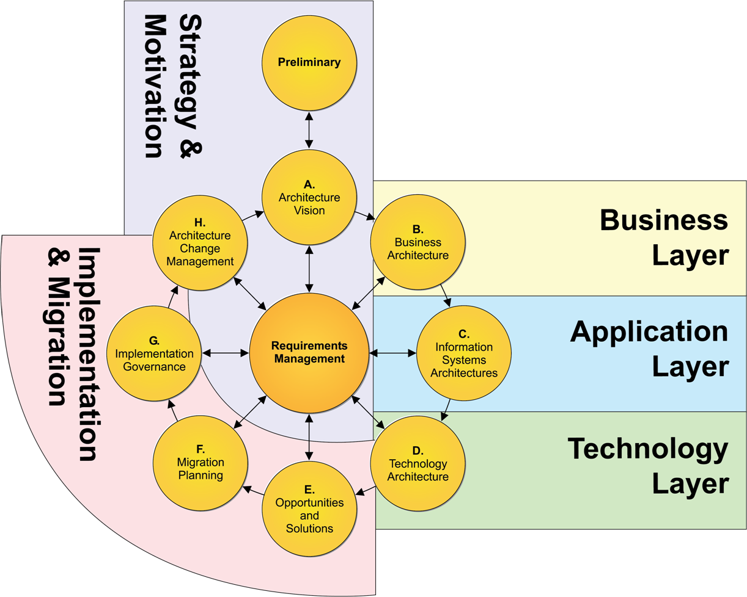
Strategy & Motivation
Source: https://pubs.opengroup.org/architecture/archimate3-doc/apdxd.html

Slide 13
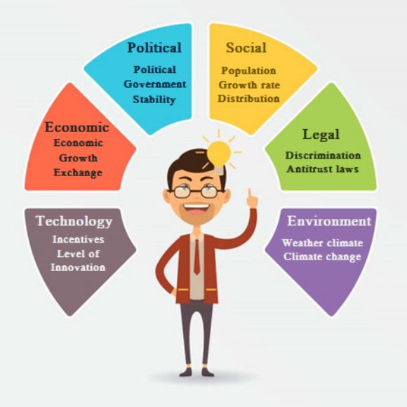
http://www.freeonlinetemplate.com/free-management-templates/pestle-analysis/pestle-analysis-free-templates/

Slide 14
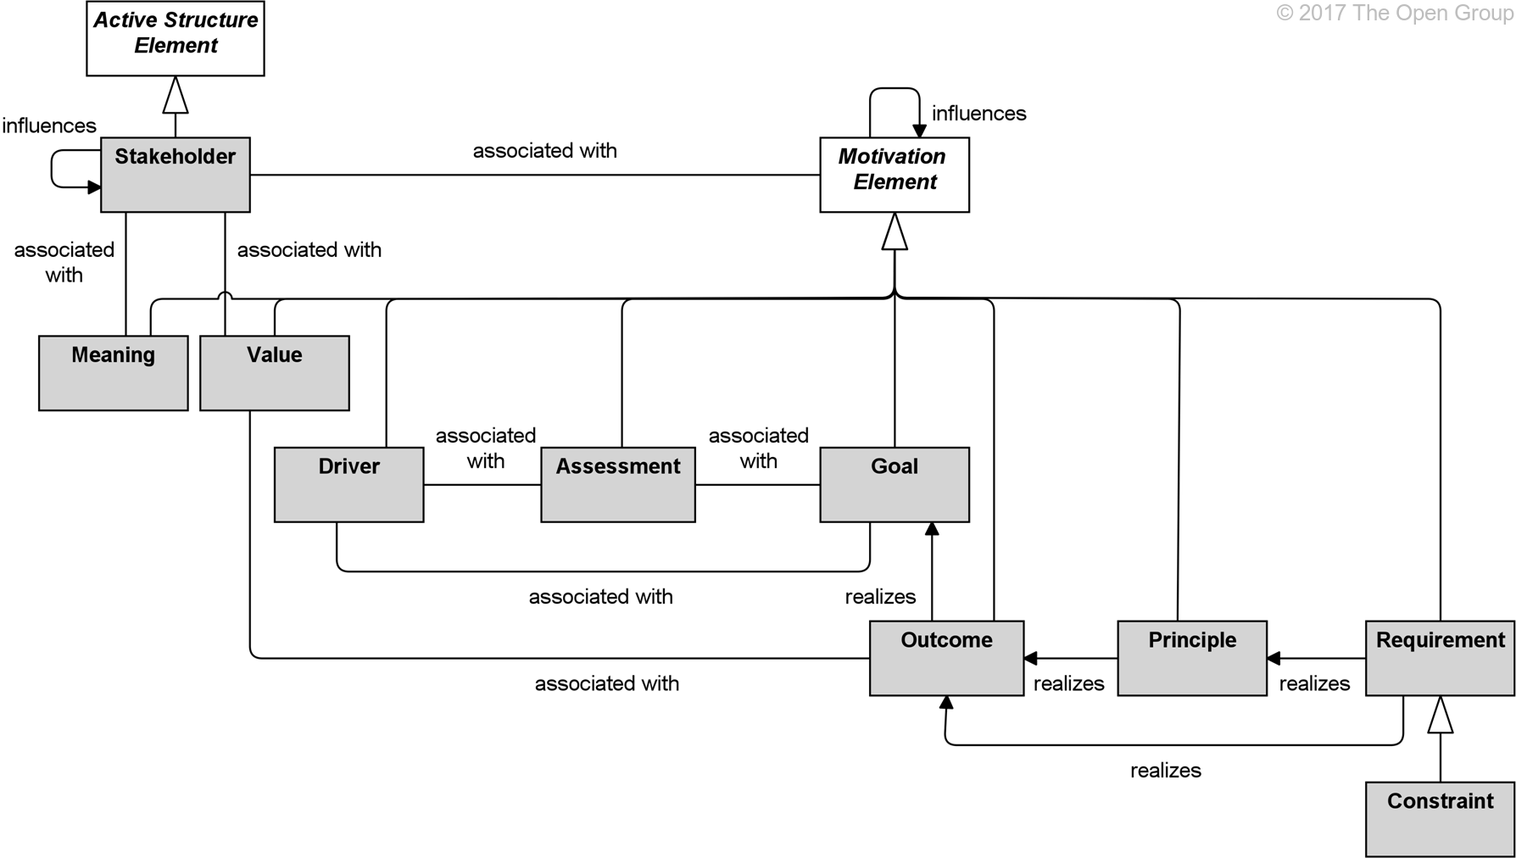
ArchiMate Motivation Layer
Discussion – What elements are most useful for an environmental analysis?
Source: https://pubs.opengroup.org/architecture/archimate3-doc/chap06.html#_Toc489946010

Slide 15
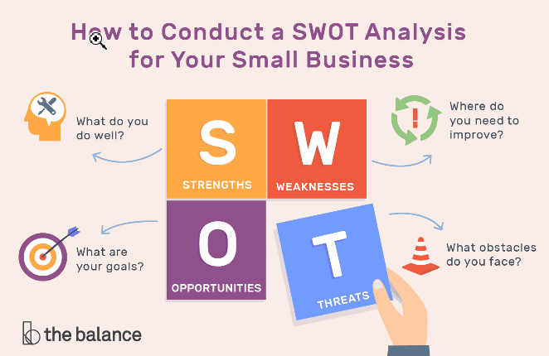
https://www.thebalancesmb.com/swot-analysis-for-small-business-2951706

Slide 16
ArchiMate Motivation Layer
Discussion – What elements would you use to conduct a SWOT analysis?
Source: https://pubs.opengroup.org/architecture/archimate3-doc/chap06.html#_Toc489946010

Slide 18
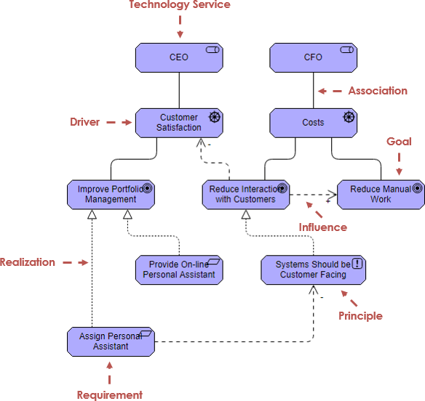
Motivation Layer – Elements and Relations
Source: https://pubs.opengroup.org/architecture/archimate3-doc/chap06.html#_Toc489946010
Notes:
shutterstock_250760995

Slide 19
Assignment 2 – Define the Strategic Intent
Characterise your chosen organisation in your own words and set the stage for it.
1. Conduct an environmental analysis to gain a better market overview
2. Identify opportunities for the future to differentiate your organisation from the competition
3. Define the vision and mission statements for your organisation
4. Define strategic goals aligned with the vision/ mission
5. Use design thinking methods to identify ideas to accomplish your strategic goals
Use management methods of your choice. Define suitable viewpoints out of the ArchiMate language to communicate your findings. Create ArchiMate views on your findings.

