Slide 1
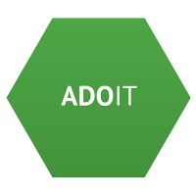

Enterprise Architecture Management
ArchiMate – Introduction & Definitions
Supported by: www.adoit-community.com

Slide 2
Agenda
Introduction
Definitions

Slide 3
What is Architecture?
“The fundamental concepts or properties of a
system in its environment embodied in its
elements, relationships, and in the principles
of its design and evolution.”
Source: ISO/IEC/IEEE 42010: 2011 Systems and software engineering — Architecture description

Slide 4
What is an Enterprise Architecture?
An enterprise architecture is typically developed because key people have concerns that need to be addressed by the business and IT systems within the organization.
Such people are commonly referred to as the ‘stakeholders’ in the system.

Slide 5
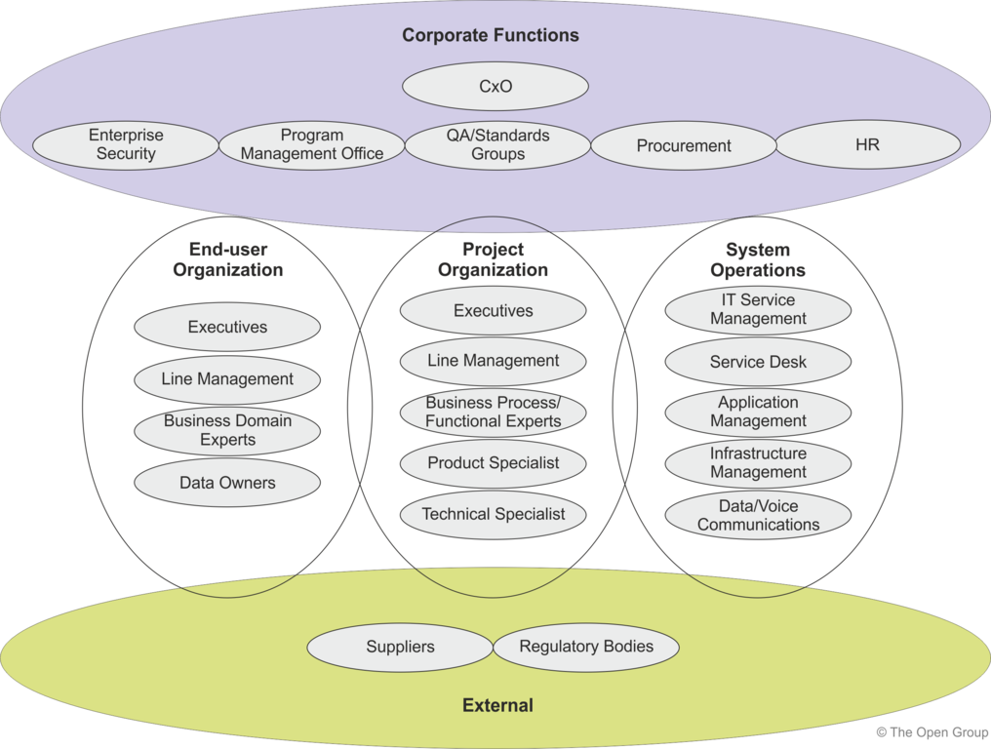
Stakeholders
SOURCE: https://pubs.opengroup.org/architecture/togaf9-doc/arch/chap21.html

Slide 6
What are Architecture Descriptions?
Architecture descriptions are formal descriptions of an enterprise, organized in a way that supports reasoning about the structural and behavioral properties of the system and its evolution.
Notes:
https://www.shutterstock.com/de/image-vector/architecture-background-302308229

Slide 7
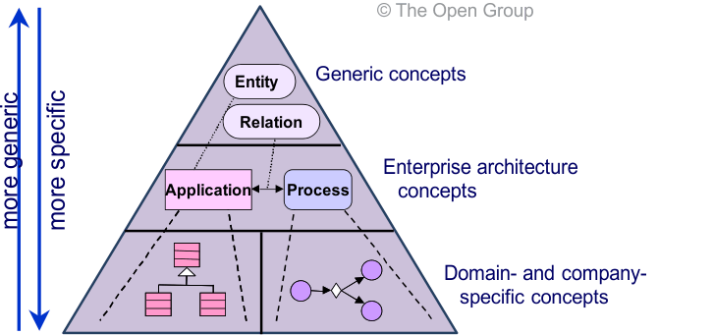
Metamodels at Different Levels of Specificity
e.g. ArchiMate
e.g. UML class diagram for data
e.g. BPMN for business processes

Slide 8
Test Yourself Question
Relationship between ArchiMate, BPMN and UML
ArchiMate fully substitutes UML and BPMN
ArchiMate may substitues UML but not BPMN
ArchiMate is designed for other industries than UML and BPMN
ArchiMate complements UML and BPMN

Slide 9
Agenda
ArchiMate [Definitions]
Notes:
shutterstock_523858522

Slide 10
Definitions – Elements and Relationships
Element A basic unit in the ArchiMate metamodel. Used to define and describe the constituent parts of Enterprise Architectures and their unique set of characteristics.
Source: ArchiMate 3 3.0 §2.10
Relationship A connection between a source and target concept. Classified as structural, dependency, dynamic, or other.
Source: ArchiMate 3 3.0 §2.13
Concept Either an element or a relationship.
ArchiMate 3.0 §2.5

Slide 11
Definitions – Elements and Relationships
Example
Concepts
Element
Relation

Slide 12
Definitions
Model A collection of concepts in the context of the ArchiMate language structure.
ArchiMate 3.0 §2.12

Slide 13
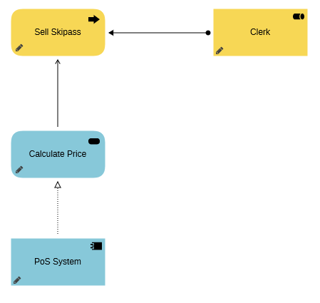
Definitions - Model
Example

Slide 14
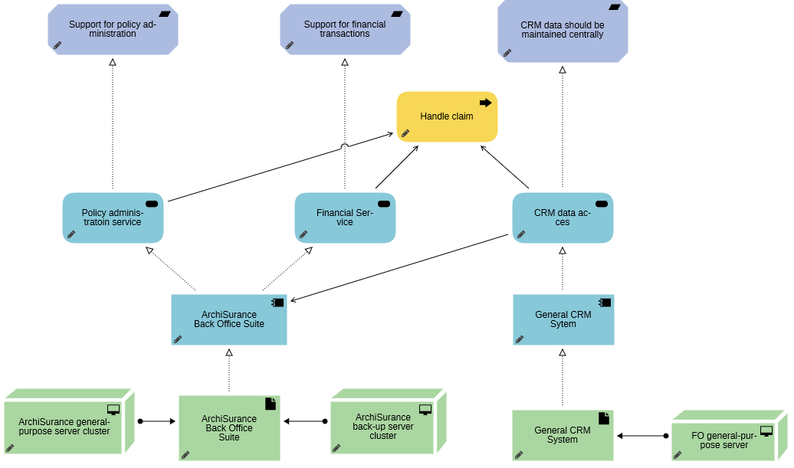
Definition - Models
Another example

Slide 15
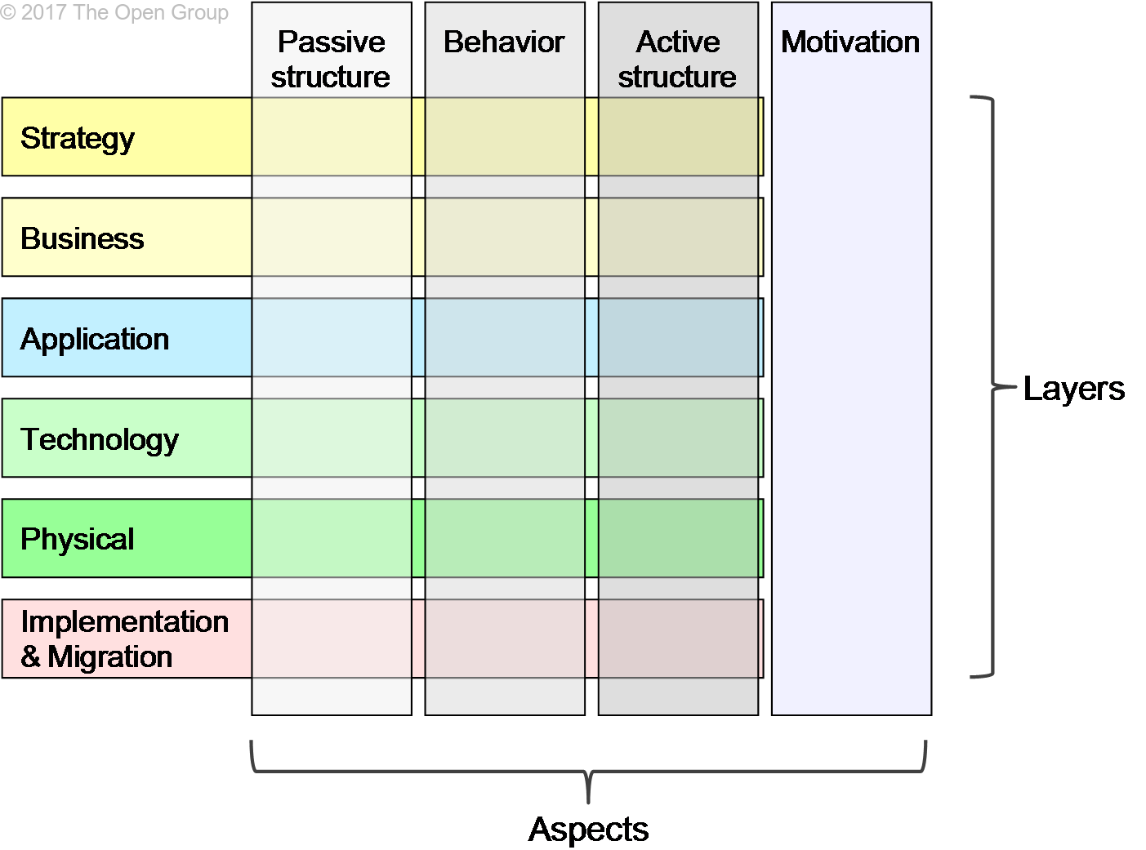
Definitions – ArchiMate Core Framework
ArchiMate Core Framework
A reference structure used to classify elements of the ArchiMate language. It consists of three layers and three aspects.
ArchiMate 3.0 §2.1
ArchiMate Core Framework

Slide 16
Definitions – Aspects and Layers (1/2)
Aspect Classification of elements based on layer-independent characteristics related to the concerns of different stakeholders. Used for positioning elements in the ArchiMate metamodel.
ArchiMate 3.0 §2.3
Layer An abstraction of the ArchiMate framework at which an enterprise can be modeled.
ArchiMate 3.0 §2.11

Slide 17
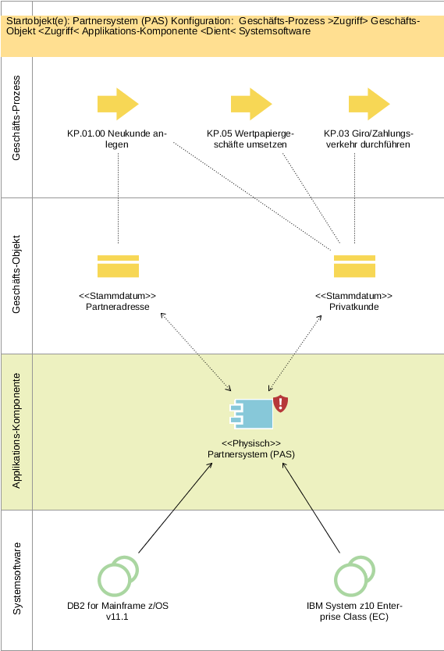
Enterprise Architecture Management mit ArchiMate
Ein Beispiel zu den ArchiMate Core Layers

Slide 18
Enterprise Architecture Management mit ArchiMate
Ein Beispiel zu den ArchiMate Core Aspects

Strukturelemente werden mit eckigen Kanten dargestellt.
ArchiMate 3.0 §3.9
Objekt
„Was?“
Verb
„Wie?“
Subjekt
„Wer?“

Slide 19
Enterprise Architecture Management mit ArchiMate
Ein Beispiel zu den ArchiMate Core Aspects

Verhaltenselemente werden mit runden Ecken dargestellt.
ArchiMate 3.0 §3.9
Objekt
„Was?“
Verb
„Wie?“
Subjekt
„Wer?“

Slide 20
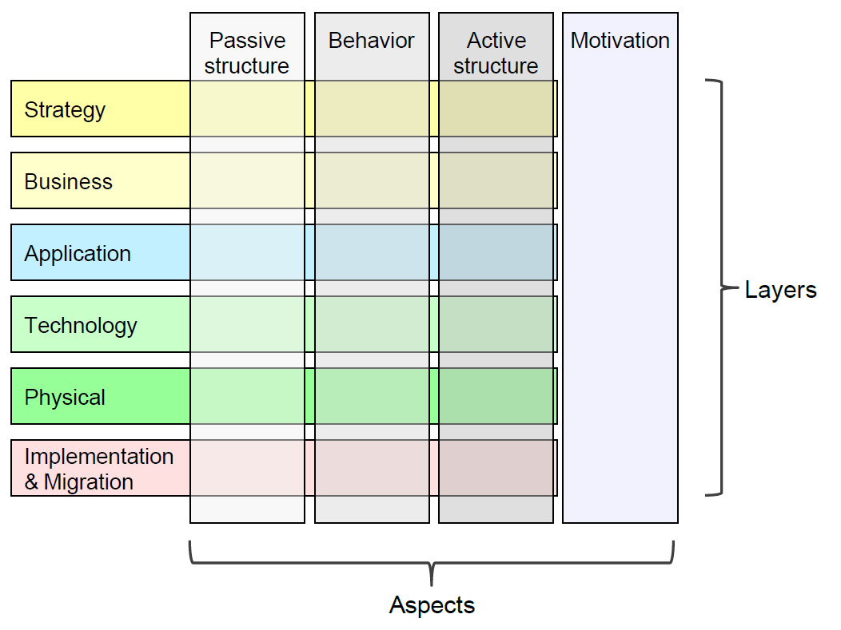
Enterprise Architecture Management mit ArchiMate
Das vollständige ArchiMate Rahmenwerk

Motivationselemente
(außer Value & Meaning) werden mit diagonalen Ecken dargestellt.
ArchiMate 3.0 §3.9
Source: http://pubs.opengroup.org/architecture/archimate3-doc/

Slide 21
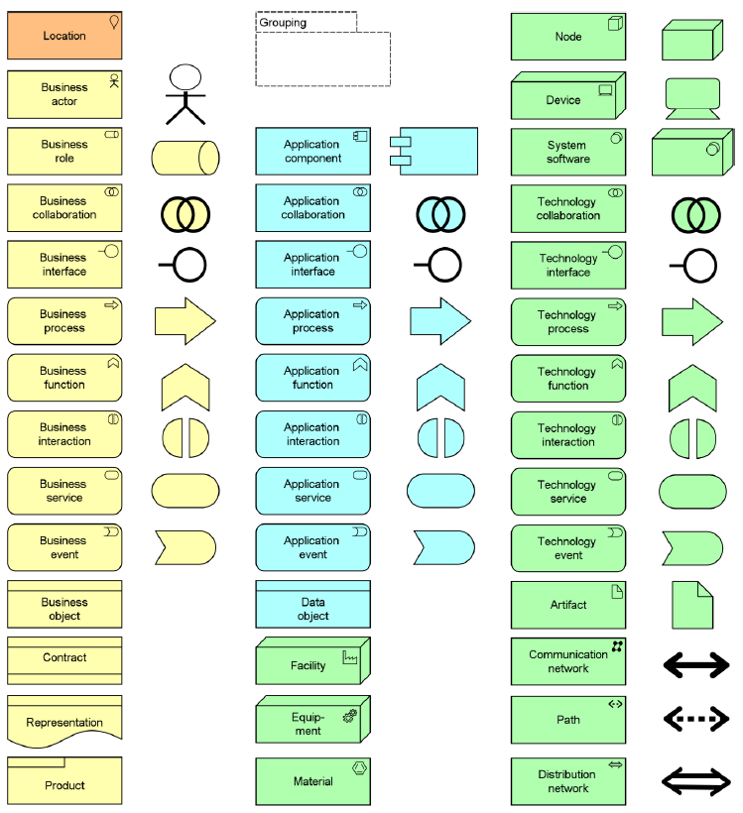
Enterprise Architecture Management mit ArchiMate
Übersicht aller ArchiMate Elements
ArchiMate Core Elements
ArchiMate Additional Elements
Source: http://pubs.opengroup.org/architecture/archimate3-doc/

Slide 22
Test Yourself Question
Which of these describes a stakeholder?
A person or group that has a concern about a system
A stockholder who owns shares to the organisation
The company executives
All members of the organisation

Slide 23
Test Yourself Question
Complete the sentence. The different layers of Enterprise Architectures that can be modeled with the ArchiMate language include business,
application, and technology
capability, and course of action
motivation, and strategy
passive structure, and behaviour

Slide 24
Test Yourself Question
Which of the following best describes the ArchiMate language?
It provides a uniform representation for diagrams describing enterprise architecture
It includes an integrated approach for describing and visualizing different architecture domains and the relationships between them
It represents enterprise architectures as they change over time
It addresses different stakeholders
All of the above

Slide 25
Test Yourself Question
Which layers does the ArchiMate consist of?
Strategy, Business, Application, Technology, Physical, Implementation and Migration
Business, Application, Technology, Motivation, Implementation and Migration
Business, Application, Technology
Active, Behaviour, Passive

Slide 26
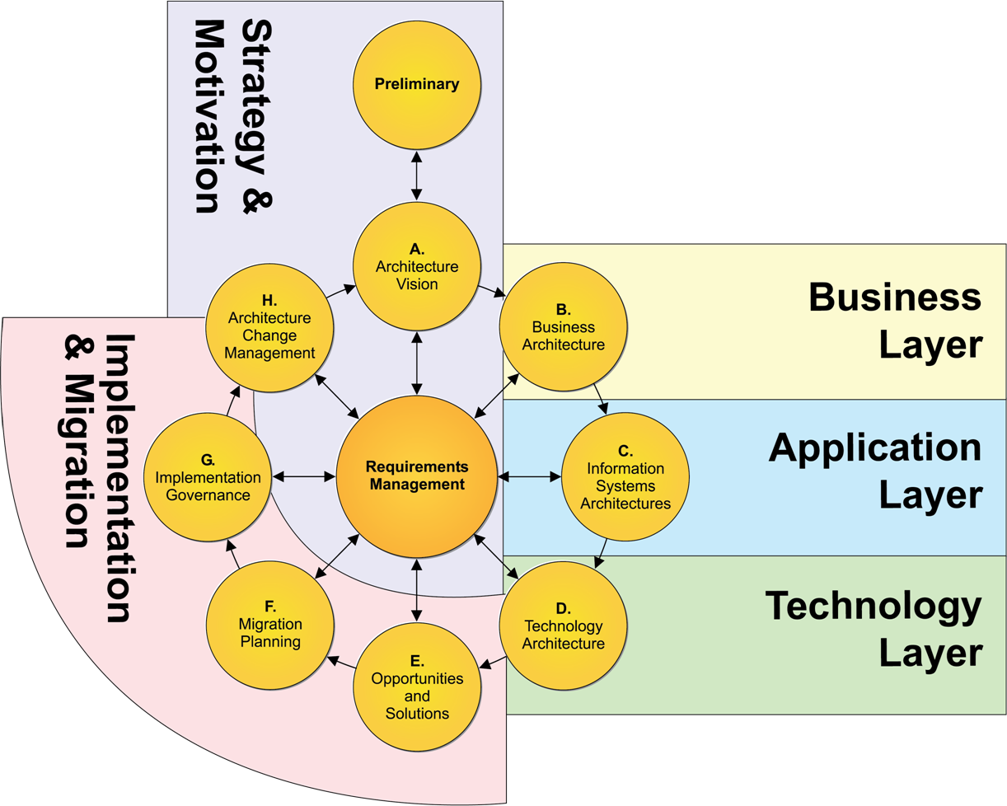
Strategy & Motivation
Source: https://pubs.opengroup.org/architecture/archimate3-doc/apdxd.html

Slide 27
Assignment 3 – Define your architecture vision
Having defined a course of action, now the team has to work on the architecture vision. Envision a target architecture that addresses the problem you are intended to solve. Make sure that your vision addresses the stakeholder concerns and objectives.
Find an appropriate method to communicate your architecture vision. Hint: Check TOGAF (Phase A: Architecture Vision, https://pubs.opengroup.org/architecture/togaf91-doc/arch/chap07.html) to better understand the requirements in this phase of your EA challenge.
Notes:
shutterstock_250760995

