Slide 1
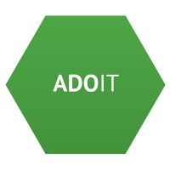

Enterprise Architecture Management
Introduction to ArchiMate – Business Architecture
Supported by: www.adoit-community.com

Slide 2
Agenda
ArchiMate Application Layer
Notes:
shutterstock_523858522

Slide 4
Agenda
Application
Notes:
https://www.shutterstock.com/de/image-photo/white-chalk-paint-texture-on-black-712639246

Slide 5
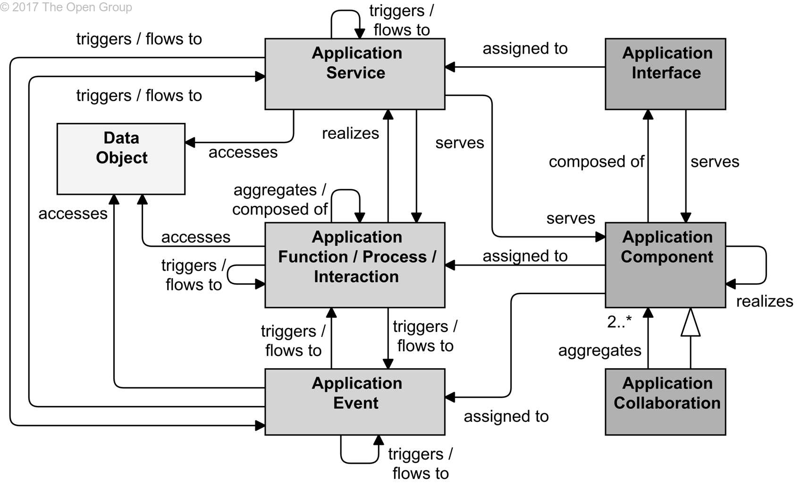
Application Layer Metamodel
Source: ArchiMate 3, 9 Application Layer

Slide 6
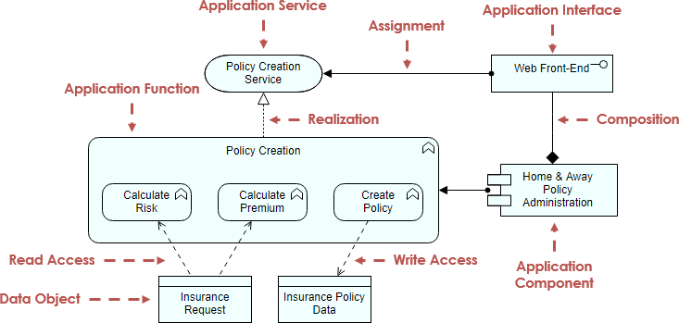
Application Layer - Elements & Relations

Slide 7
Test Yourself Questions
Difference between service and function
Service and functions describe the same behaviour and can be substituted
Service represents external behaviour while function internal one
Function is an obsolete term and has been replaced by service
Service represents business behavior, function represents application behaviour

Slide 8
Test Yourself Question
What is the best interpretation of the diagram?
Product Offer function provides Product Details service to ERP application
Contact Management, Product Offer and Campaign Management are internal CRM processes
ERP application provides a service that is consumed by Product Offer function of CRM
Product Details in an application interface which is used by CRM to access ERP functionalities

Slide 9
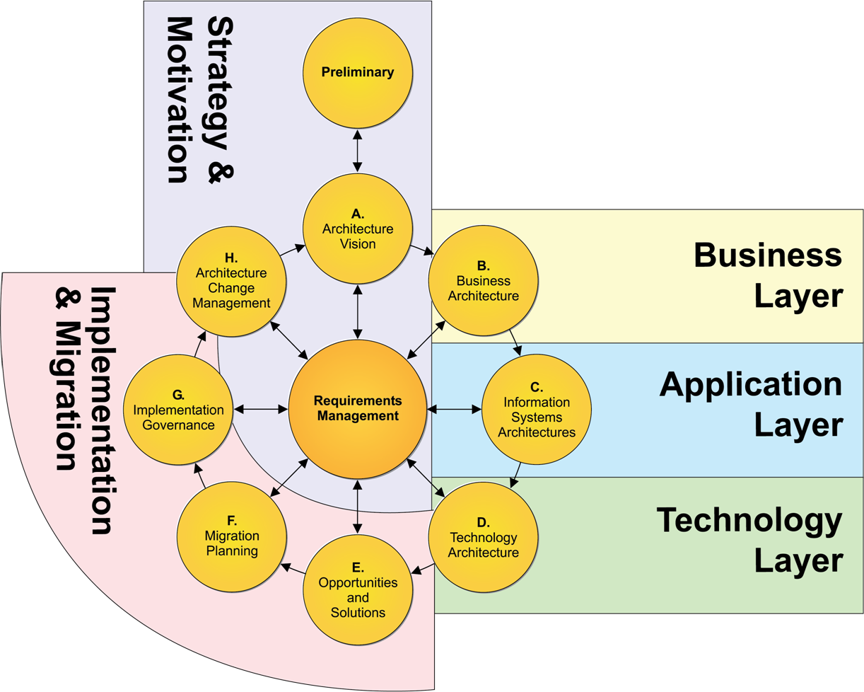
Application layer
Source: https://pubs.opengroup.org/architecture/archimate3-doc/apdxd.html

Slide 10
Discuss in your group: What elements are most important for your individual transformation challange? Why? Present the results in the classroom!
Source: ArchiMate 3, 9 Application Layer

Slide 11
Assignment 5 – Design the application architecture
Design the target application architecture of your transformation initiative. Chose an adequate viewpoint from ArchiMate. At minimum you have to use elements such as application components and application services.
Furthermore, you have to identify all relevant data objects that are accessed by your application components.
Make sure that your application architecture aligns to the business architecture of the previous assignment.
Before you begin the modelling task, define and discuss a suitable view point for the task at hand.
Hint: Check TOGAF (Phase C Information Systems Architectures,
https://pubs.opengroup.org/architecture/togaf91-doc/arch/chap09.html) to better understand the requirements in this phase of your EA challenge.
Notes:
shutterstock_250760995

