Slide 1

Enterprise Architecture Management
Introduction to ArchiMate – The Technology Layer
Supported by: www.adoit-community.com

Slide 2
Agenda
ArchiMate Technology Layer
ArchiMate Extensions
Notes:
shutterstock_523858522

Slide 3
Agenda
Technology
Notes:
https://www.shutterstock.com/de/image-photo/white-chalk-paint-texture-on-black-712639246

Slide 5
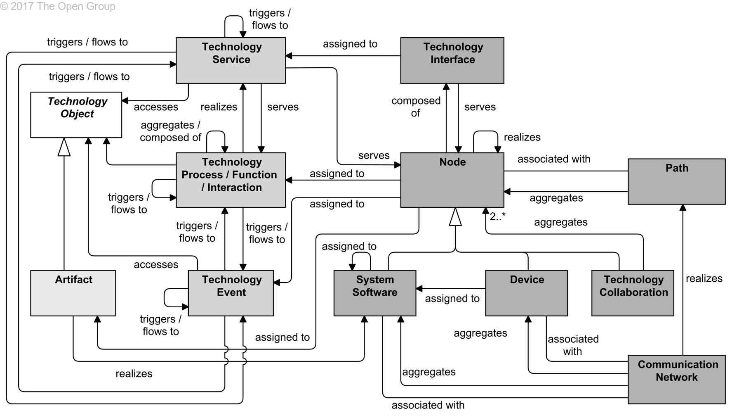
Technology Layer Metamodel
Source: ArchiMate 3, 10 Technology Layer

Slide 6
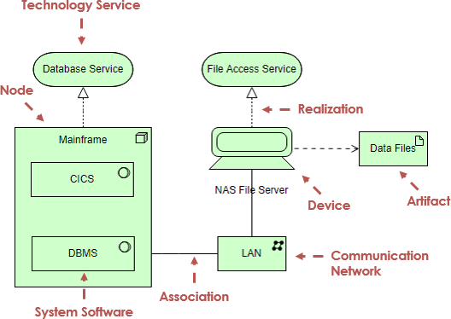
Technology Layer - Elements & Relations

Slide 7
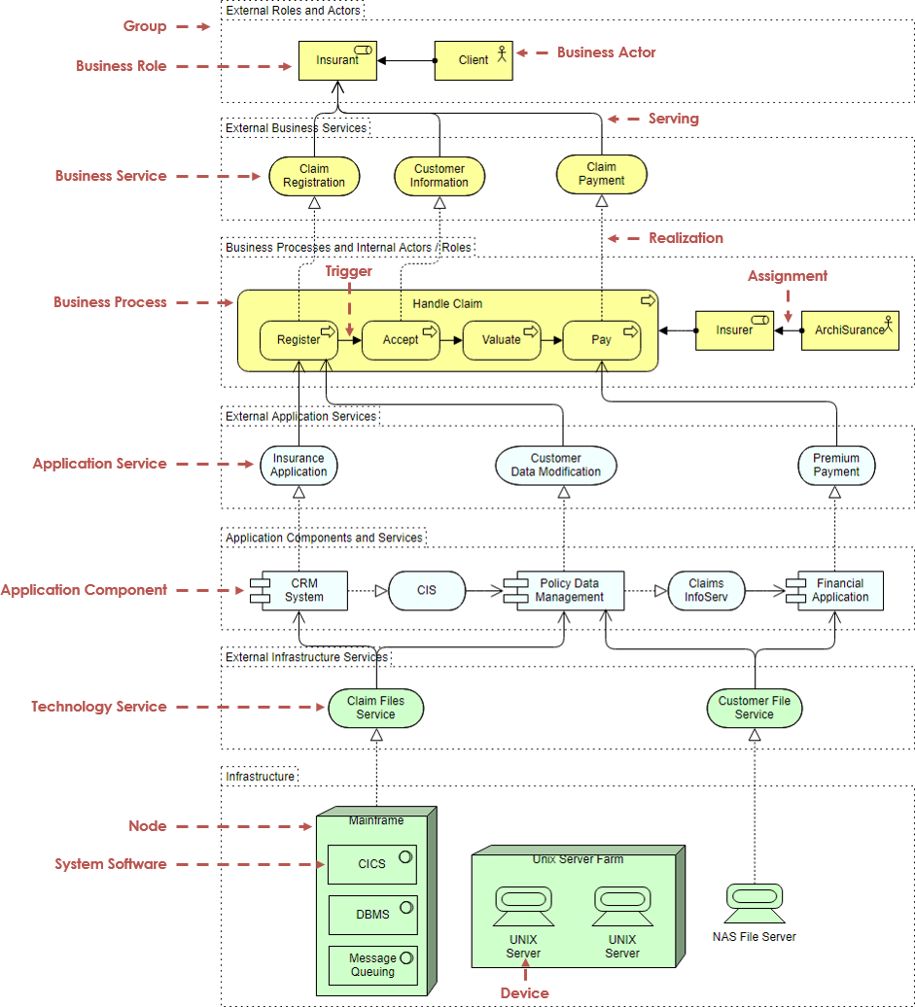
Tying it all together – Cross Layer View

Slide 8
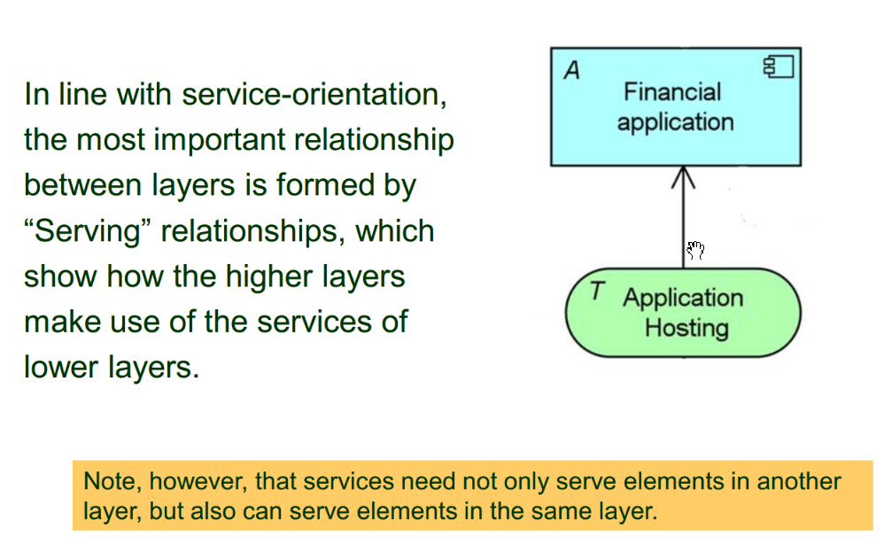
Cross Layer Relationship: Serving

Slide 9
Cross Layer Relationship: Realization

Slide 10
What is false statement about colours in ArchiMate?
There is no prescription for using colours in ArchiMate, you can use any colours
In addition to colours, letters S, B, A, T, P, I may be used to distinguish between the layers
ArchiMate defines yellow, blue and green for business, application and technology layers
It is recommended to use colours to highlight elements and relationships in visualisations

Slide 11
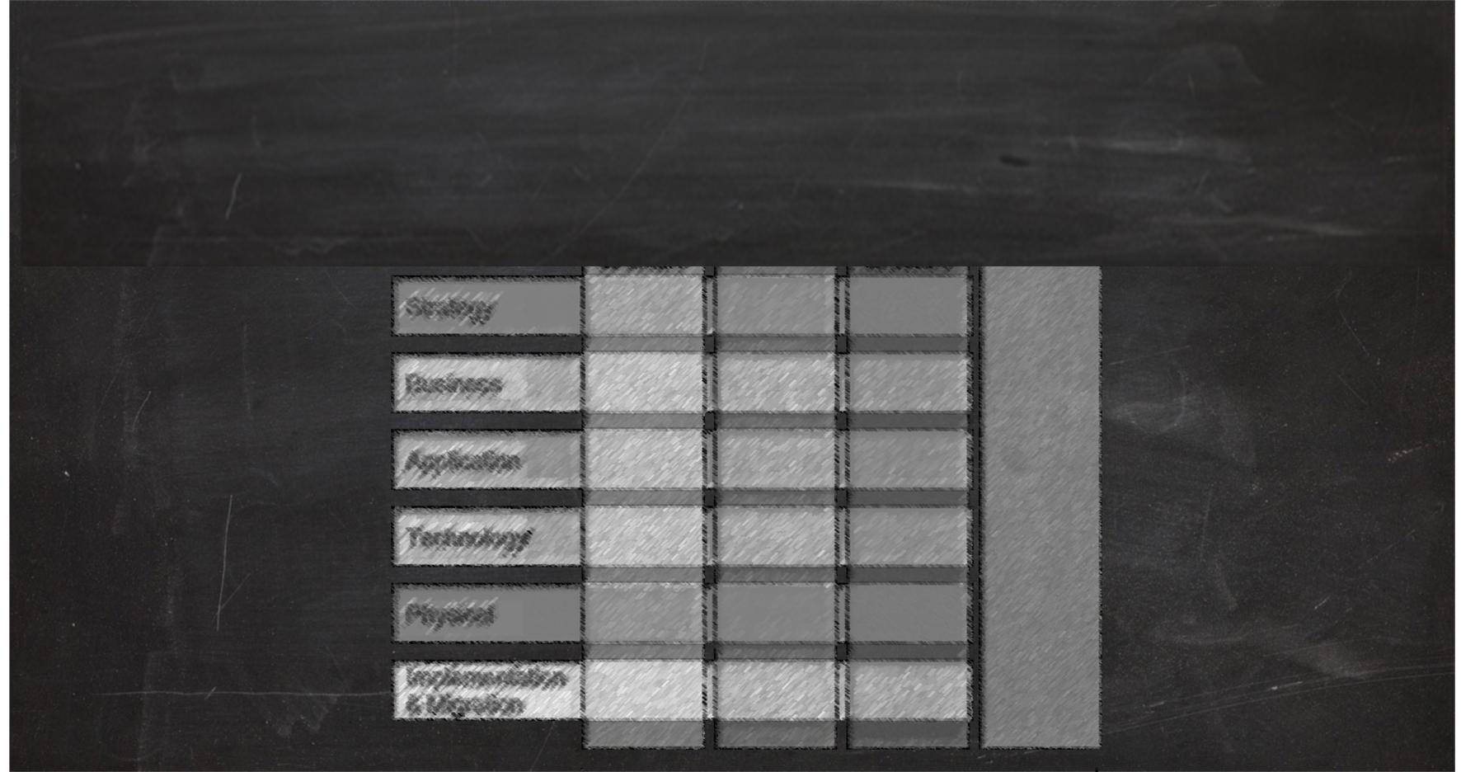
Agenda
Extension Layers
Iand Motivation Aspect)

Slide 12
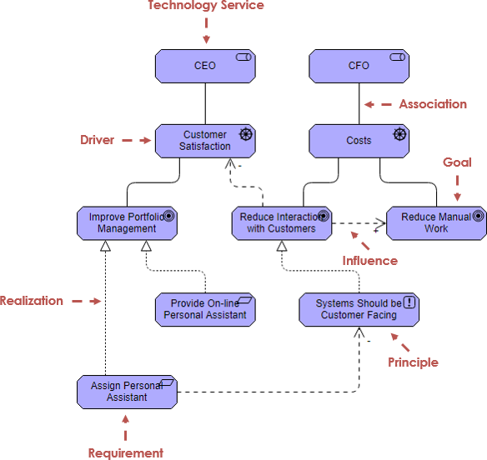
Motivation – Elements and Relations

Slide 13
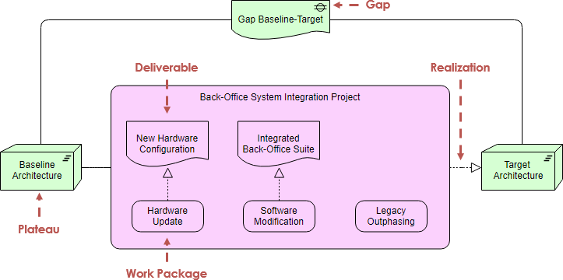
Implementation and Migration Extension

Slide 14
Test Yourself Question
What colour should elements on the Business Layer be?
Yellow
Green
Blue
ArchiMate does not specify the colours of entities

Slide 15
Test Yourself Question

Slide 16
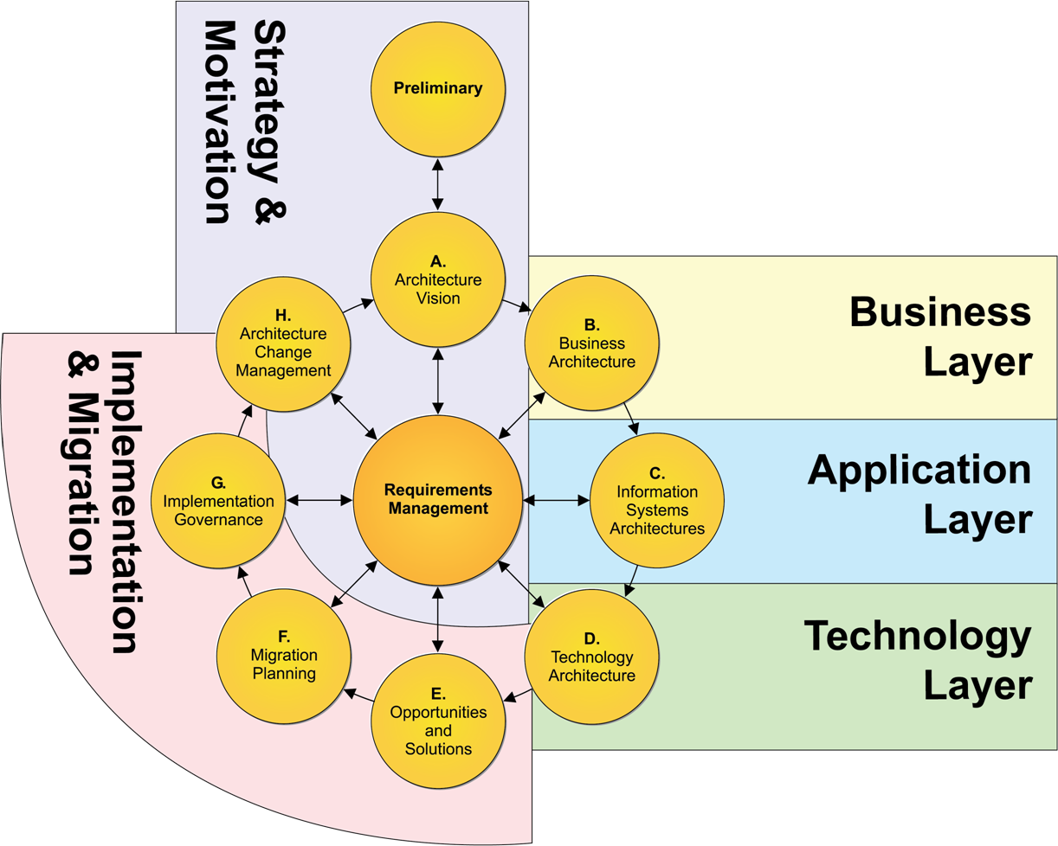
Technology layer
Source: https://pubs.opengroup.org/architecture/archimate3-doc/apdxd.html

Slide 17
Discuss in your group: What elements are most important for your individual transformation challange? Why? Present the results in the classroom!
Source: ArchiMate 3, 10 Technology Layer

Slide 18
Assignment 6 – Design the technology architecture
Design an adequate technology architecture that supports your transformation initiative. Chose an adequate viewpoint from ArchiMate. Discuss possible alternative designs.
Make sure that your technology architecture is aligned with the business architecture and the information systems architecture and that all relevant relations are mapped.
Before you begin the modelling task define and discuss a suitable viewpoint for the task at hand.
Notes:
https://www.shutterstock.com/de/image-vector/industrial-western-sahara-map-blue-homework-1507184135

