Slide 1

Basics of BPMN
BOC Academy Programme
BOC Academy Programme See more on www.boc-group.com/academy-programme

Slide 2
Your Key Takeaway from this Lecture
1
2
3
What is BPMN?
Why do we need standards for process modelling?
What are the basic elements of BPMN?

Slide 3
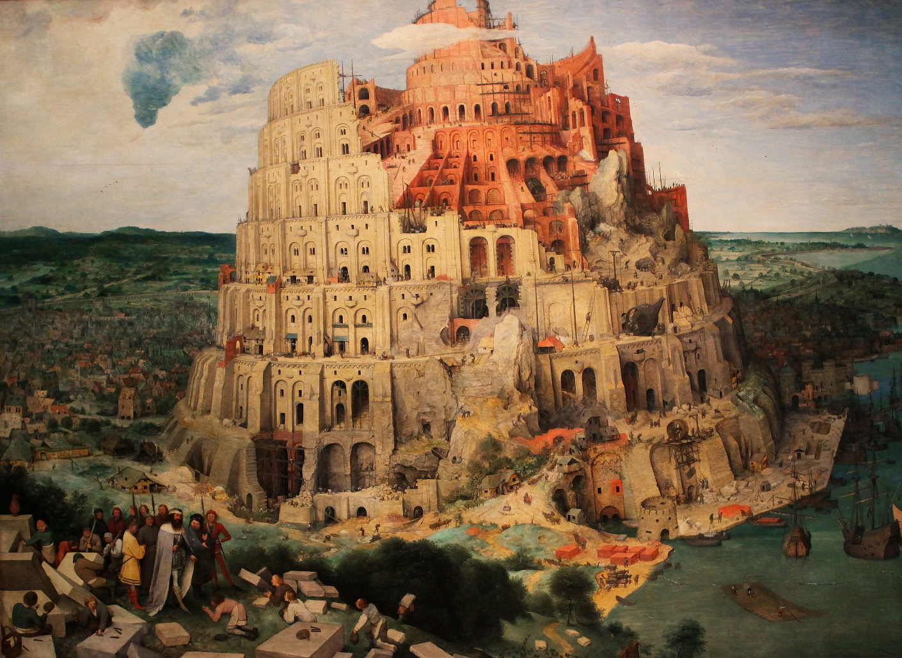
Why do we need Standards?
The story of the Tower of Babel explains the confusion of tongues: variation in human language.

Slide 4
Problems with Communication
Common problem of many organizations – different „languages” used by…
IT
Business
Managers
Etc.
This often leads to problems, which can be summarized as:
„I thought you understood what I meant!”
!

Slide 5
BPMN – Brief History
Original name Business Process Modeling Notation
Created by the Business Process Modeling Initiative consortium
Open standard for modelling, implementation and presentation of business processes
v1.0 in 2004
Maintained by OMG (Object Management Group)
v2.0 in 2011 (now BPMN stands for Business Process Model and Notation)
Current version v2.0.2 = ISO/IEC 19510:2013

Slide 6
Why BPMN?
Common language for processes
Vendor-independent standard (with 200+ implementations)
BPMN Diagram Interchange (DI) as standard to exchange diagrams (e.g. from Business Process Analysis tools to Process Automation tools)
Centralized support and further development of the standard by OMG
Freely available at http://www.omg.org/spec/BPMN/Current
Widely accepted

Slide 7
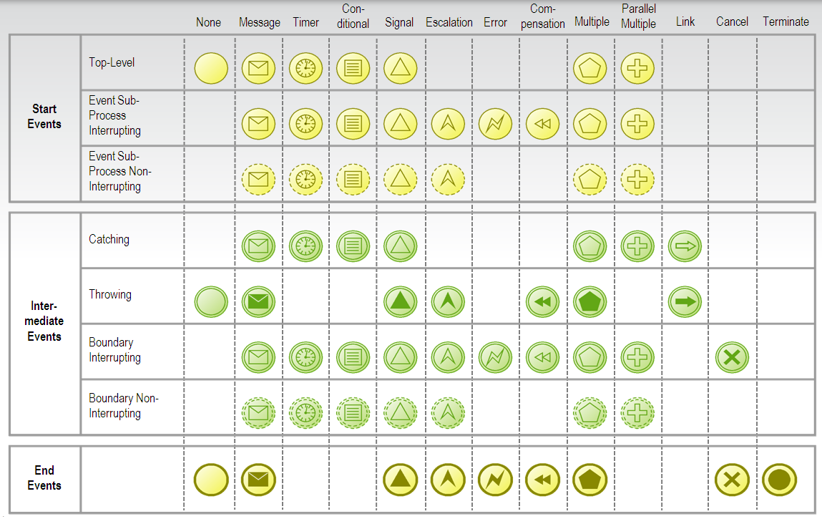
Common complaint: BPMN has 100+ symbols…

Slide 8
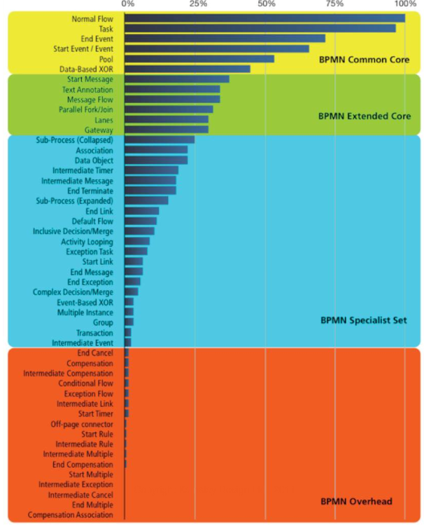
BPMN and its Symbols
BPMN indeed contains many symbols
Research shows that only a very small subset of them is sufficient for understanding most of the diagrams
You can learn it like any spoken language – by focusing on basics first and getting answers for your most important questions
Graphics: Sandy Kemsley http://www.column2.com/
Source: How Much Language is Enough? Theoretical and Practical Use of the Business Process Modeling Notation, Michael zur Muehlen, Jan Recker

Slide 9
Example
What do we want to know while driving?

Slide 10
Possible Answers to this Question
How fast am I driving?
Do I have enough fuel?
Am I late for the meeting?
Knowing what to focus on allows you to avoid distractions
!

Slide 11
What do we want to Know about a Process?
 | What can start a process?
 | How does my process end?
 | What can happen during the process?
 | What do we do in a process?
 | How does the process flow?
 | Who does what in a process?
 | … and possibly many more.
BPMN can answer many of those questions

Slide 12
BPMN Elements!
 | What can start a proces?
 | How does my process end?
 | What can happen during the proces?
 | What do we do in a proces?
 | How does the process flow?
 | Who does what in a process?
 | … and possibly many more.
Events
Activities
Gateways
Swimlanes
BPMN can answer many of those questions

Slide 13
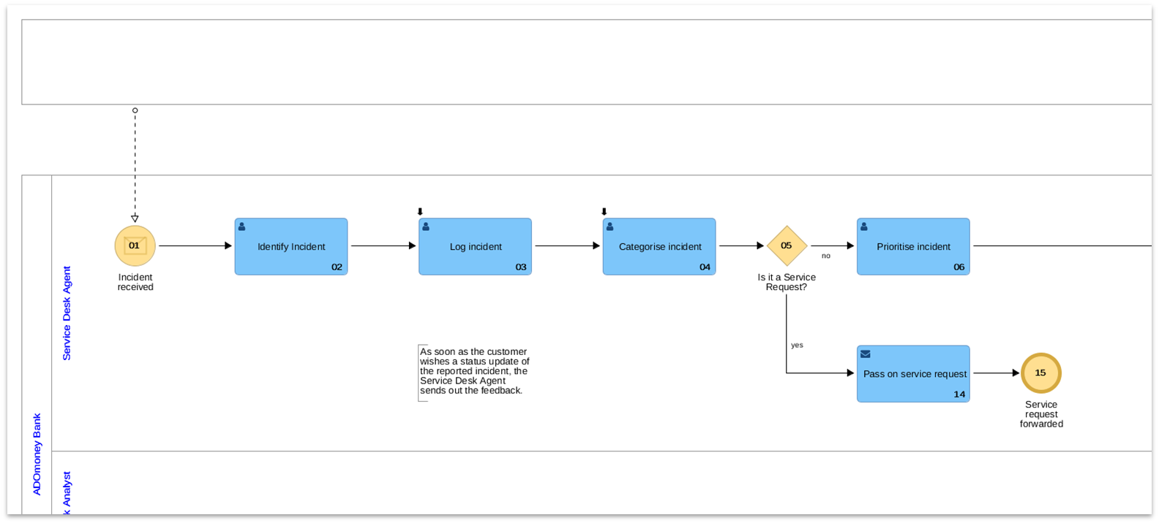
Events
Let’s take a look at an example BPMN diagram
(Start) Event
(End) Event
Events are depicted as circles
They allow you to document important events influencing the process flow (especially start and end)

Slide 14
Activities
Let’s take a look at an example BPMN diagram
Activity
Activities (Tasks and Subprocesses) are shown as rounded rectangles
They allow you to document work performed in a process

Slide 15
Gateways
Let’s take a look at an example BPMN diagram
Gateway
Gateways are depicted as diamonds
They help you to show where process paths can split and/or merge

Slide 16
Sequence Flow
Let’s take a look at an example BPMN diagram
Sequence Flow
Sequence Flow is shown as an arrow drawn with a solid black line and filled arrowhead
It shows in which order process steps are performed
There are even more types of „arrows”, which in BPMN are called Connecting Objects

Slide 17
Swimlanes
Let’s take a look at an example BPMN diagram
Pool
Lane
Swimlanes (Pools and Lanes) are shown as rectangles
They help you to show who performs which activities and its context (Pools).

Slide 18
Self Assessment
 | BPMN currently stands for…?
 | BPMN is maintained by…?
 | Which of the BPMN elements is used to show how the process starts?
 | Which of the BPMN elements is used to split process flows?
 | Which of the BPMN elements is used to connect elements of the process flow?
 | Tasks and Subprocesses belong to the BPMN category called…?

Slide 19
Self Assessment – Solutions
 | BPMN currently stands for…? | Business Process Model and Notation
 | BPMN is maintained by…? | Object Management Group (OMG)
 | Which of BPMN elements is used to show how the process starts? | (Start) Event
 | Which of BPMN elements is used to split process flows? | Gateway
 | Which of BPMN elements is used to connect elements of the process flow? | Sequence Flow
 | Tasks and Subprocesses belong to the BPMN category called…? | Activity

Slide 20
Test your Knowledge in Practice
This set of slides is only one part of the package provided to BPM educators by BOC Group
You can learn more about the BOC Academy Programme and register for a teacher or student account at www.boc-group.com/academy-programme
Inside the account you will find the exercises which allow you to practice what you have learned from the slides.
Suggested exercises for this set of slides:
Exercise 1.2 to 1.7

Slide 21
Do you want to use ADONIS at Work?
Contact us and test the next generation of BPM
Ready for the next step?
Learn more about the professional editions of ADONIS NP!
Details here www.boc-group.com/adonis

Slide 22
BOC Group Webinars
Discover our Comprehensive Offering of free Webinars

ON-DEMAND BPM WEBINAR

ON-DEMAND EA WEBINAR

FURTHER WEBINARS
Maturity and Performance of BPM, Digital Transformation, ISO 9001:2015, Workflow-based Process Execution, Process Optimization and many more!
Value Creation through Architecture Management, How to start your EA, EU-GDPR, Optimize your IT, Making Archimate business fit and many more!
Achieve Success in Quality, Process and Risk Management, End-to-End Transformation, Knowledge Management, Confluence Integration and many more!
www.boc-group.com/webinars
More than 25 free live or on-demand webinars on current industry-relevant topics in three languages!
Join our free Webinars:
www.boc-group.com/webinars

Slide 23
Fancy to work at BOC Group?
We certainly got the right thing for you
Bachelor or Master Thesis
Internships and Practical Work Experience
Exciting Job Offers with great Career Opportunities in Consulting, Sales, Programming and much more
Simply get in touch with us!
www.boc-group.com/career
  

Slide 24
Do you have a specific request?
Contact us at www.boc-group.com/contact.

Slide 25
English References
http://www.omg.org/spec/BPMN/Current
https://column2.com/2008/03/the-great-bpmn-debate/
M. zur Muehlen, J. Recker “How Much Language is Enough? Theoretical and Practical Use of the Business Process Modeling Notation”
German References
Prozessmanagement für Experten: Impulse für aktuelle und wiederkehrende Themen, Franz Bayer, Harald Kühn, Springer 2013

